Slide 1
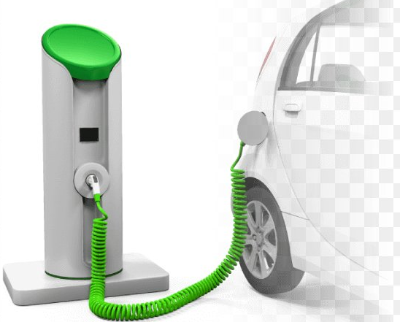
ELECTRIC VEHICLES CHARGING INFRASTRUCTURE
Objectives Review Guide | Open Data University | P23 Tech for Good and Design Thinking
Professor: F. Canterino - Tutor: S. Cesari De Maria
A.Y. 2022 – 2023
Luca Desimoni (2200145)
Arij Ben Rhouma

Slide 2
AGENDA
1
Context and Presentation of the Structure
2
Reformulation of the Identified Need and the Proposed Project
3
Planning and Objectives
4
Validation of Next Steps

Slide 3

CONTEXT AND PRESENTATION OF THE STRUCTURE
In France, the transport sector is responsible for 38% of CO2 emissions
Goal: sets as a goal the end of the sale of new fossil fuels vehicles using by 2040
Strong growth of registrations of electric vehicles
For the electric vehicle model to be viable, it is necessary to have a public charging station for 10 cars (AFI Directive)
Objective: homogeneous territorial coverage!

Slide 4
REFORMULATION OF THE IDENTIFIED NEED
How is the number of charging infrastructures changing in France?
Does the distribution of charging infrastructure on the territory correspond to a logic of population distribution and road traffic?
Encourage the development of electric mobility: give greater visibility to charging infrastructures, since it is an important factor in the decision to purchase an electric vehicle

Slide 5


PLANNING AND OBJECTIVES
Exploiting Open Data University Resources:
• Heatmaps and Graphs: comparing the distribution of charging infrastructures with the road traffic
• Recommendations and insights

Slide 6
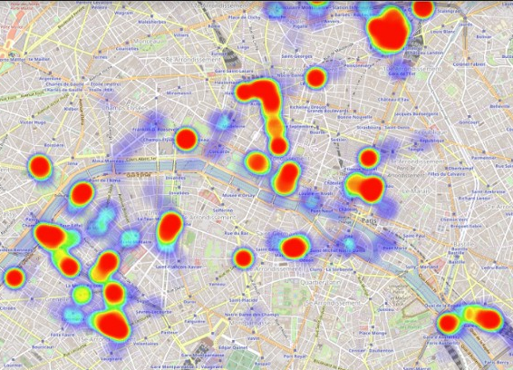
VALIDATION OF NEXT STEPS
Heatmaps and Graphs
Recommendations and insights
Using Python programming language
Looking and analyzing the graphs
”It should be done …"

Slide 7

Thank you for your attention!

